Slide 1
28-03-2019
Processes to Run an Object Program
Loading
Brings object program into memory
Relocation
Modifies the object program where absolute addresses are specified
Linking
Combines two or more separate object programs and supplies information needed to allow cross- references.
Absolute loader
Loader
Linking loader
Linker
Program Linking
A program is a logical entity that combines all of the related control sections.
Control sections could be assembled together, or they could be assembled independently of one another.
Control sections are to be linked, relocated, and loaded by loaders.
External references among control sections can be assigned addresses after these control sections are loaded into memory by loaders.
1

Slide 2
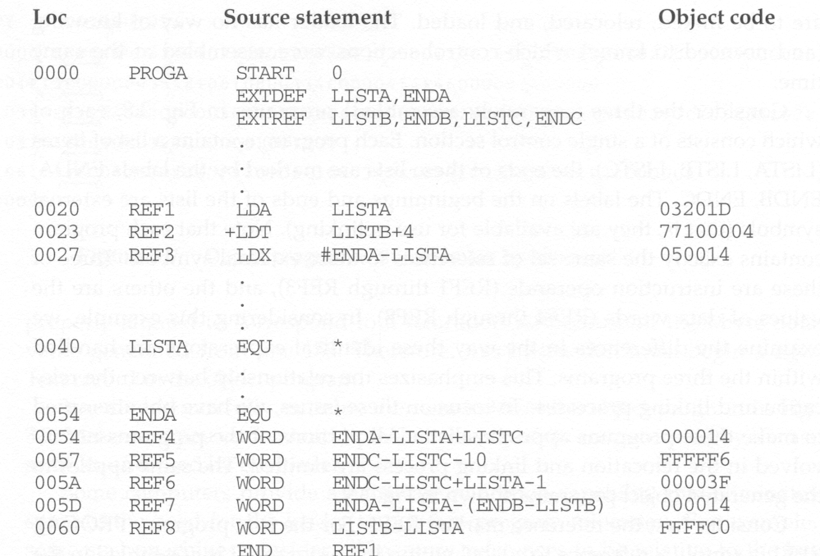
28-03-2019
LDA | 00
LDT | 74
LDX | 04
Sample Program for Linking and Relocation
1

Slide 3
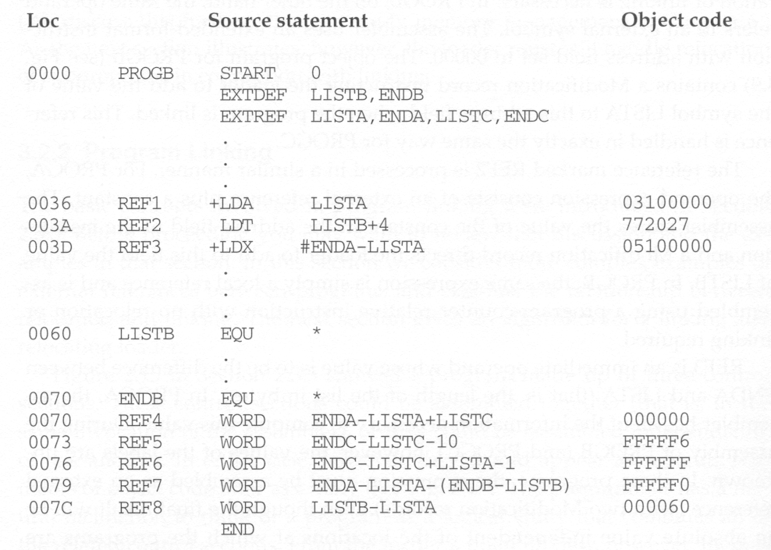
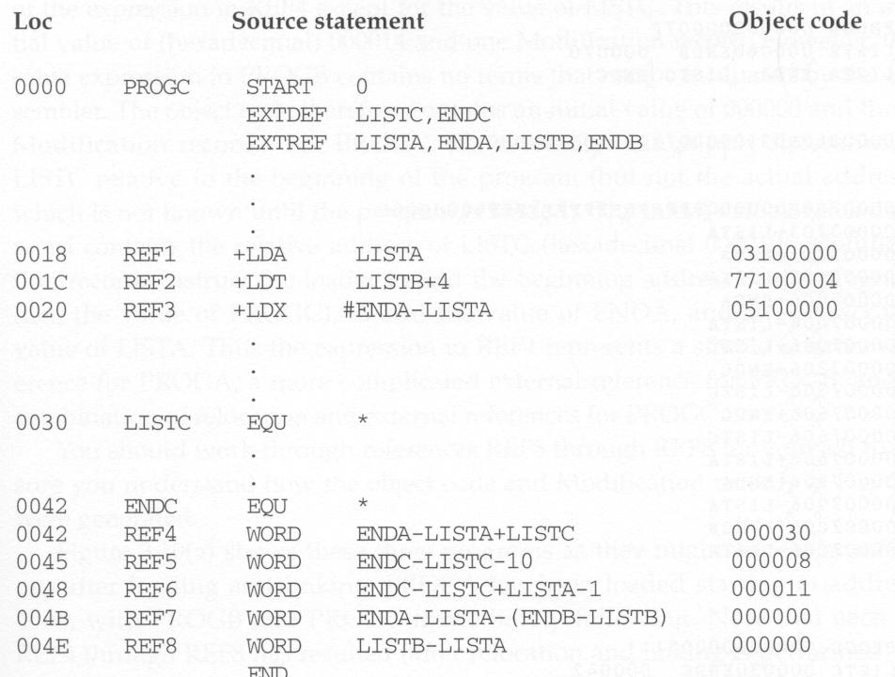
28-03-2019
Sample Program for Linking and Relocation
Sample Program for Linking and Relocation
1

Slide 4
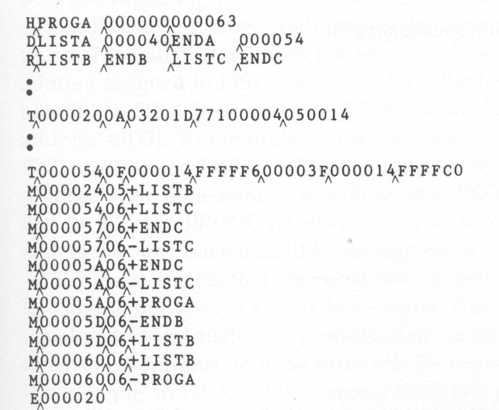
28-03-2019
Sample Program for Linking and Relocation
Each control section defines a list:
Control section A: LISTA --- ENDA
Control section B: LISTB --- ENDB
Control section C: LISTC --- ENDC
Each control section contains exactly the same set of references to these lists
REF1 through REF3: instruction operands
REF4 through REF8: values of data words
After these control sections are linked, relocated, and loaded, each of REF4 through REF8 should have resulted in the same value in each of the three control sections. (but not for REF1 through REF3, why?)
Object Code of Control Section A
1

Slide 5
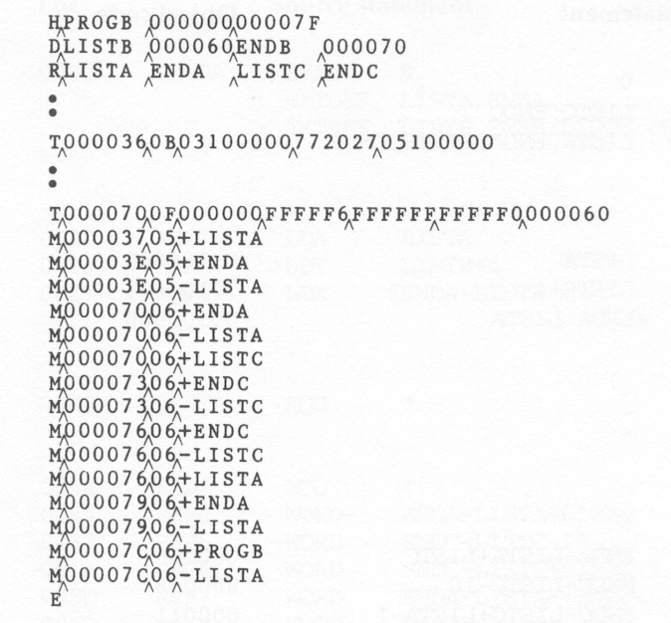
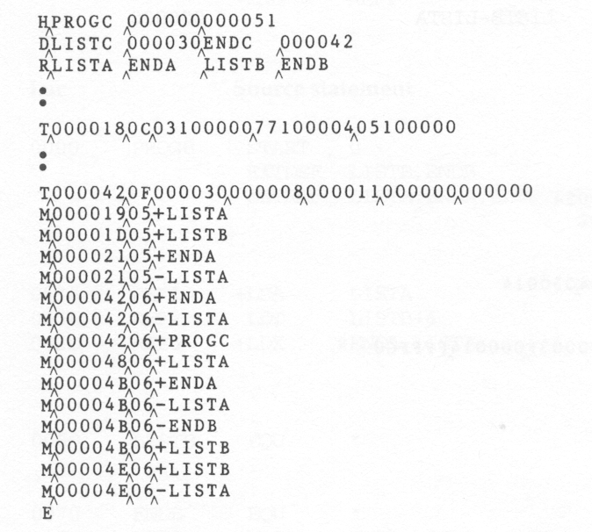
28-03-2019
Object Code of Control Section B
Object Code of Control Section C
1

Slide 6
28-03-2019
REF1 (LISTA)
Control section A
LISTA is defined within the control section.
Its address is immediately available using PC-relative addressing.
No modification for relocation or linking is necessary.
Control sections B and C
LISTA is an external reference.
Its address is not available thus an extended-format instruction with address field set to 00000 is used.
A modification record is inserted into the object code to instruct the loader to add the value of LISTA (once determined) to this address field.
REF2 (LISTB+4)
Control sections A and C
REF2 is an external reference (LISTB) plus a constant.
The address of LISTB is not available thus an extended-format instruction with address field set to 00004 is used.
A modification record is inserted into the object code to instruct the loader to add the value of LISTB (once determined) to this address field.
Control section B
LISTB is defined within the control section.
Its address is immediately available using PC- relative addressing.
No modification for relocation or linking is necessary.
1

Slide 7
28-03-2019
REF3 (#ENDA-LISTA)
Control section A
ENDA and LISTA are defined within the control section.
The difference between ENDA and LISTA is immediately available.
No modification for relocation or linking is necessary.
Control sections B and C
ENDA and LISTA are external references.
The difference between them is not available thus an extended-format instruction with address field set to 00000 is used.
Two modification records are inserted into the object code
• +ENDA
-LISTA
REF4 (ENDA-LISTA+LISTC)
Control section A
The values of ENDA and LISTA are known when assembled. Only the value of LISTC is unknown.
The address field is initialized as 000014 (ENDA-LISTA).
One Modification record is needed for LISTC:
• +LISTC
Control section B
ENDA, LISTA, and LISTC are all unknown.
The address field is initialized as 000000.
Three Modification records are needed:
• +ENDA
-LISTA
• +LISTC
Control section C
LISTC is defined in this control section but ENDA and LISTA are unknown.
The address field is initialized as the relative address of LISTC ( 000030)
Three Modification records are needed:
• +ENDA
-LISTA
• +PROGC (for relocation)
1

Slide 8
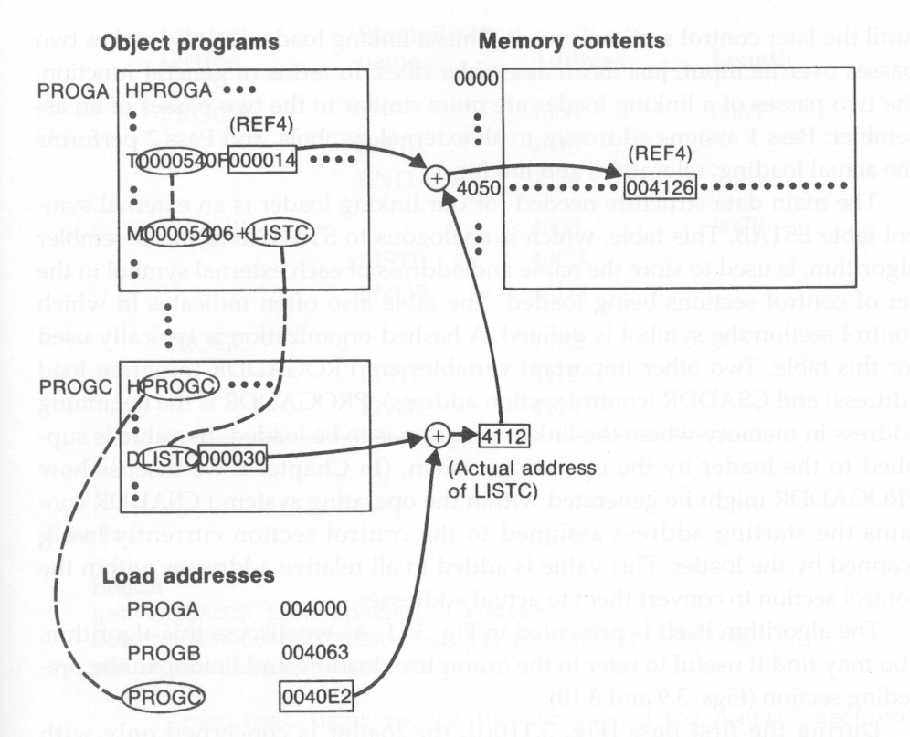
28-03-2019
Calculation of REF4 (ENDA-LISTA+LISTC)
Calculation of REF4 (ENDA-LISTA+LISTC)
Control section A
The address of REF4 is 4054 (4000 + 54)
The value of REF4 is:
000014 + 004112 = 004126
(initial value) (address of LISTC)
The address of LISTC is:
0040E2 + 000030 = 004112
(starting address of PROGC) (relative address of LISTC in PROGC)
Control section B
The address of REF4 is 40D3 (4063 + 70)
The value of REF4 is:
000000 + 004054 - 004040 + 004112 = 004126
(initial value) (address of ENDA) (address of LISTA) (address of LISTC)
1

Slide 9
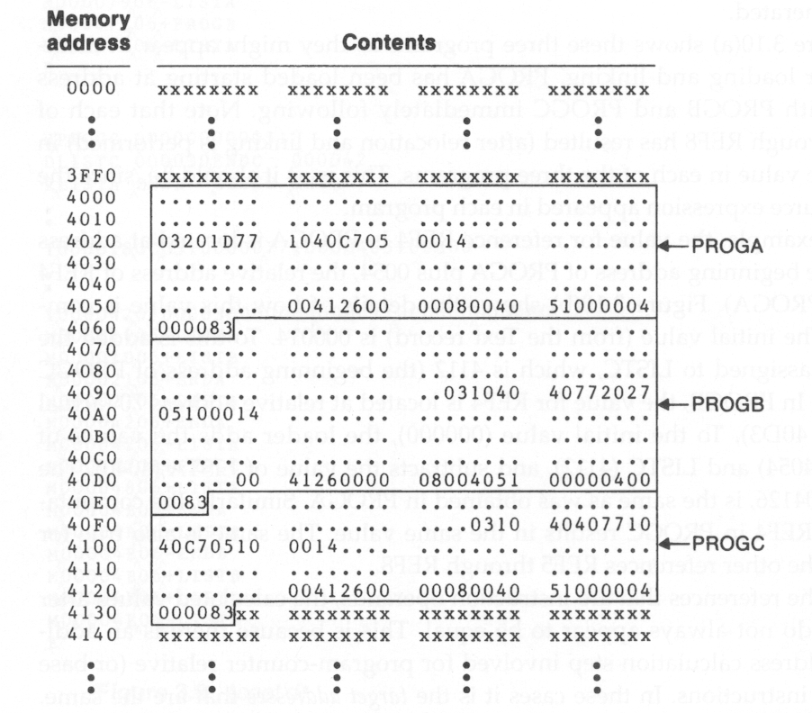
28-03-2019
REF2 (LISTB+4)
in Control section A
REF2 +LDT LISTB+4 77100004
Control section A
The address of REF2 is 4023 (4000 + 23)
The value of REF4 is:
00004 + 040C3 = 040C7
(initial value) (address of LISTB)
The address of LISTB is:
04063 + 00060 = 040C3
Program in Memory after Linking and Loading
Values of REF4, REF5, …, REF8 in three places are all the same.
started at 4000
started at 4063
started at 40E2
1

Slide 10
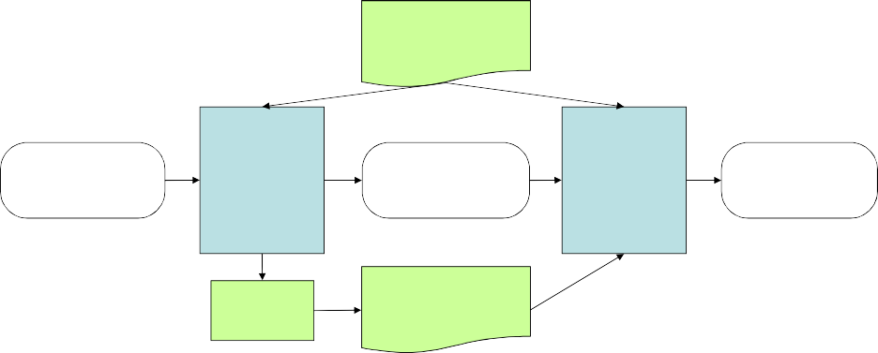
28-03-2019
References in Instruction Operands
For references that are instruction operands, the calculated values after loading do not always appear to be equal.
This is because there is an additional address calculation step involved for PC (or base) relative instructions.
In such cases, it is the target addresses that are the same.
For example, in control section A, the reference REF1 is a PC relative instruction with displacement 01D. When this instruction is executed, the PC contains the value 4023. Therefore the resulting address is 4040. In control section B, because direct addressing is used, 4040 (4000 + 40) is stored in the loaded program for REF1.
Recall: Implementation of An Assembler
Operation Code Table (OPTAB)
Symbol Table (SYMTAB)
Location Counter (LOCCTR)
OPTAB
Source program
Pass 1
Intermediate file
Pass 2
Object program
LOCCTR
SYMTAB

Slide 11
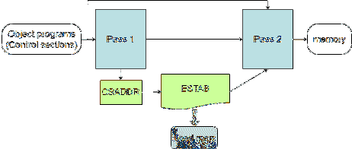
28-03-2019
Implementation of a Linking Loader
Two-pass process (similar to the Assembler):
Pass 1: assigns addresses to all external symbols
Pass 2: performs the actual loading, relocation, and linking
Object programs (Control sections)
Pass 1
Pass 2
memory
CSADDR
ESTAB
Load map
Data Structures
External Symbol Table (EST
For each external symbol, EST
its name
its address
in which control section the symbol is defined
Hashed organization
Program Load Address (PROGADDR)
PROGADDR is the beginning address in memory where the linked program is to be loaded (supplied by OS).
Control Section Address (CSADDR)
CSADDR is the starting address assigned to the control section currently being scanned by the loader.
CSADDR is added to all relative addresses within the control section.
AB)
AB stores

Slide 12
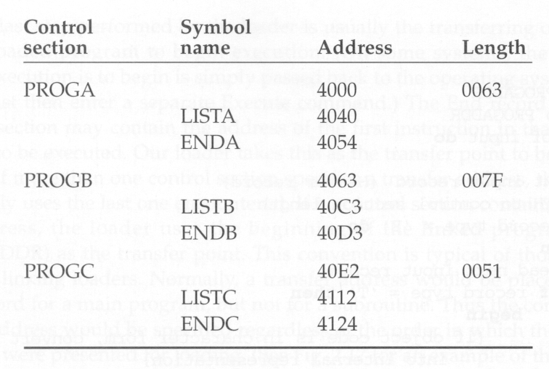
28-03-2019
A Load Map
PASS-1
loader gets the PROGADDR from operating system.
This PROGADDR becomes the starting address for the first control section.
The control section name from the Header record is entered into ESTAB with the value give by CSADDR.
All the external symbols in the Define record for the control section also entered into ESTAB.
When the End record is read , the control section length CSLTH is added to CSADDR to obtain the starting address for the next control section.
At end of the pass-1 ,ESTAB contains all the external symbols with value.

Slide 13
28-03-2019
PASS-2
pass2 performs the actual loading ,relocation and linking of the program.
As each Text record is read, the object code is moved to the specified address plus the current value of CSADDR.
When Modification record is encountered, the ESTAB is searched to find the address of the symbol specified is either added or subtracted from the indicated location in memory .
The loader then starts the execution from the address specified in the End record of the control section.
Algorithm for Linking Loader
Have a Try …

Slide 14
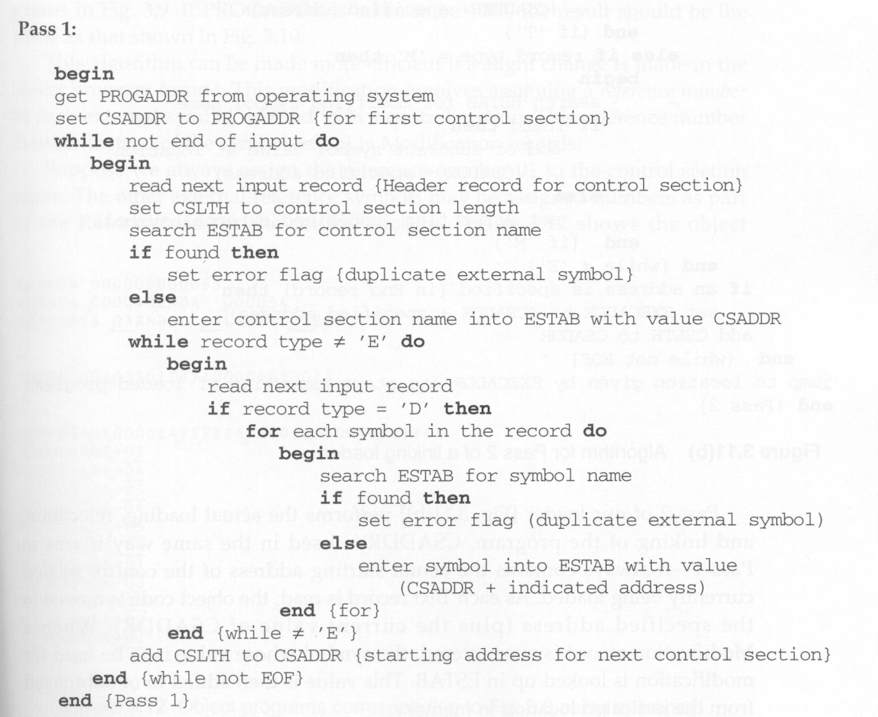
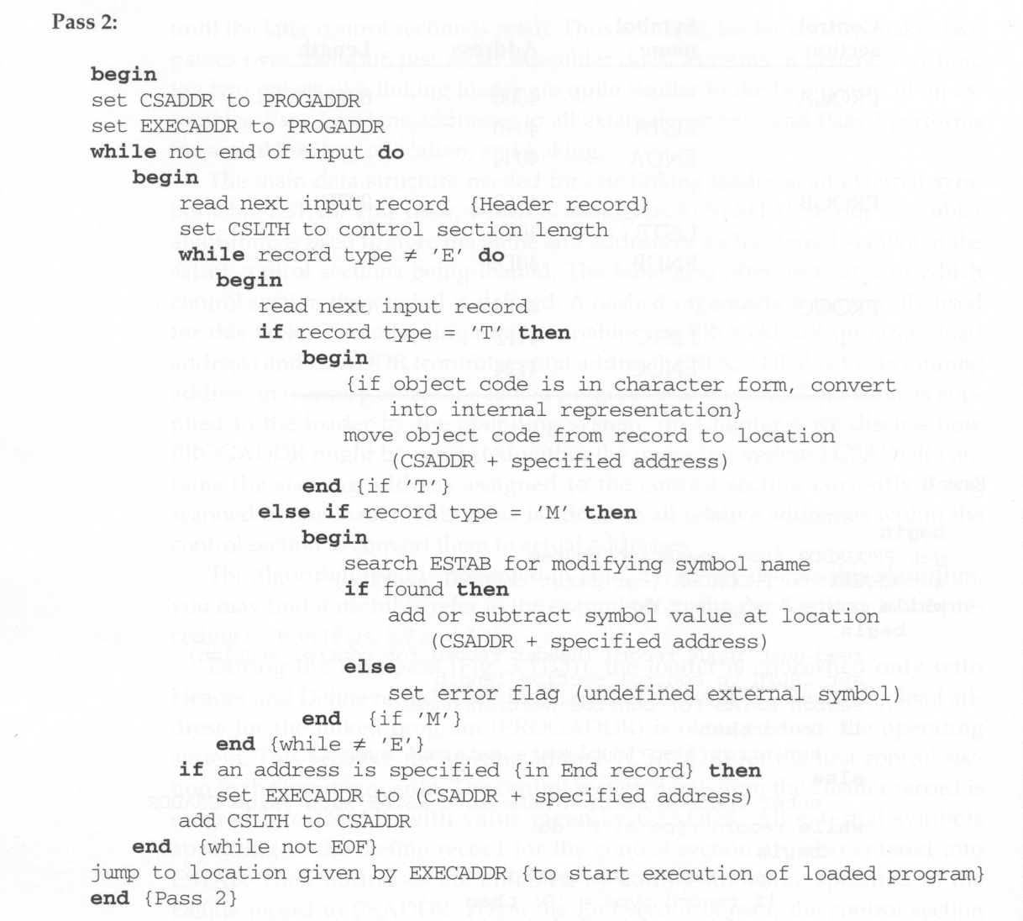
28-03-2019
(only Header and Define records are concerned)
Algorithm
Algorithm

Slide 15
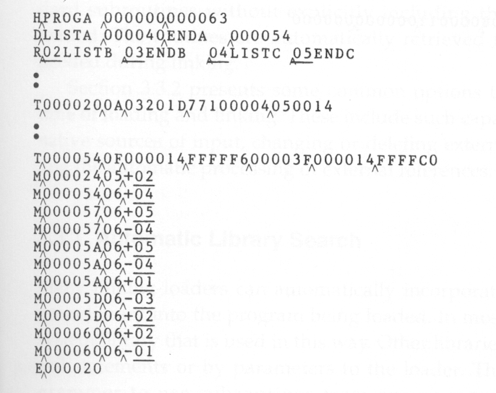
28-03-2019
Enhance the Algorithm
We can make the Assembler more efficient by storing search information in the intermediate file and avoiding the search of OPTAB in Pass 2.
We can make the linking loader algorithm more efficient by:
assigning a reference number to each external symbol referred to in a control section
Control section name: 01
Other external reference symbols (stored in the Refer records): 02symname, 03symname, …
using this reference number (instead of the symbol name) in Modification records
avoiding multiple searches of ESTAB for the same symbol during the loading of a control section.
Search of ESTAB for each external symbol can be performed once and the result is stored in a table indexed by the reference number.
The values for code modification can then be obtained by simply indexing into the table.
Examples of Using Reference Numbers

Slide 16
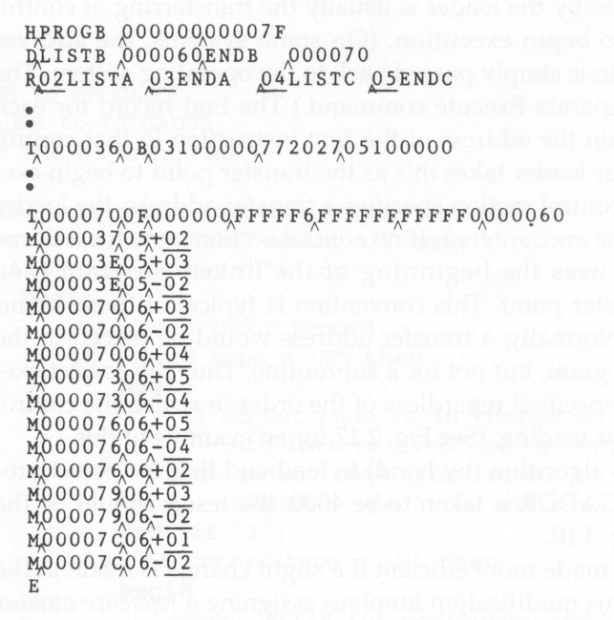
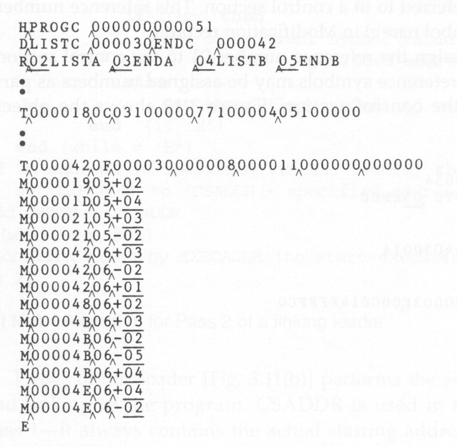
28-03-2019
Examples of Using Reference Numbers
Examples of Using Reference Numbers

Slide 17
28-03-2019
Machine-Independent Loader Features
Automatic Library Search Loader Options
Machine-Independent Loader Features
Automatic library search for handling external references
allows a programmer to use standard subroutines which are automatically retrieved from a library as they are needed during linking
Options of linking and loading
Specifying alternative sources of input
Changing or deleting external references
Controlling the automatic processing of external references

Slide 18
28-03-2019
Automatic Library Search
Goal:
automatically incorporate routines from subprogram libraries into the program being loaded
Standard system library
Libraries specified by control statements or by parameters to the loader
The subroutines called by the program are automatically fetched from the library, linked with the main program, and loaded.
The programmer does not need to take any action beyond mentioning the subroutine names as external references in the source program
Implementation of Automatic Library Search
Linking loader must keep track of external symbols that are referred to, but not defined, in the primary input to the loader.
Enter symbols from each Refer record into ESTAB and mark them undefined unless these symbols are already present
Make the symbol defined when its definition is encountered
At the end of Pass1, the symbols in ESTAB that remain undefined represent unresolved external references.
The loader searches the libraries for routines that contain the definitions of these unresolved symbols, and processes the subroutines found by this search process exactly as if they had been part of the primary input stream.
Repeat the above library search process until all references are resolved, because the fetched subroutines may themselves contain external references.

Slide 19
28-03-2019
Discussions of Automatic Library Search
The presented linking loader allows the programmer to override the standard subroutines by supplying his/her own routines.
Directory
The loader searches for the subroutines by scanning the Define records for all of the object programs.
It can be more efficient by searching a directory giving the name and address of each routine.
The same techniques applies equally well to the resolution of external references to data items.
Loader Options
Users can specify options that modify the standard processing of the loader.
How to specify options (usually using a special command language):
Separate input file
Statements embedded in the primary input stream between object programs
Loader control statements included in the source program

Slide 20
28-03-2019
Loader Options
Typical loader options:
Selection of alternative sources of input
INCLUDE program-name(library-name)
Direct the loader to read the designated object program from a library
Deletion of external symbols
DELETE csect-name
Instruct the loader to delete the named control sections from the set of programs being loaded
Change the external symbols
CHANGE name1, name2
Cause the external symbol name1 to be changed to name2
wherever it appears in the program
Automatic inclusion of library routines
LIBRARY MYLIB
Specify alternative libraries to be searched
User-specified libraries are normally searched before the standard system libraries.
NOCALL name
Specify the external reference name are to remain unresolved.
Example of Using Loader Options
In the COPY program, two subroutines, RDREC and WRREC, are used to read/write records.
Suppose that the utility subroutines contain READ and WRITE that perform the same functions of RDREC and WRREC.
Without reassembling the program, a sequence of loader commands could be used to use READ and WRITE instead of RDREC and WRREC:
INCLUDE READ(UTLIB) INCLUDE WRITE(UTLIB) DELETE RDREC, WRREC CHANGE RDREC, READ CHANGE WRREC, WRITE

Slide 21
28-03-2019
Loader Design Options
Linkage Editors Dynamic Linking Bootstrap Loaders
Linkage Editors
Difference between a linkage editor and a linking loader:
Linking loader
performs all linking and relocation operations, including automatic library search, and loads the linked program into memory for execution.
Linkage editor
produces a linked version of the program, which is normally written to a file or library for later execution.
A simple relocating loader (one pass) can be used to load the program into memory for execution.
The linkage editor performs relocation of all control sections relative to the start of the linked program.
The only object code modification necessary is the addition of an actual load address to relative values within the program.

Slide 22
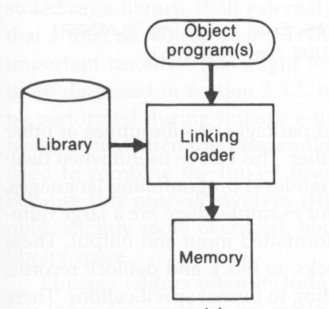
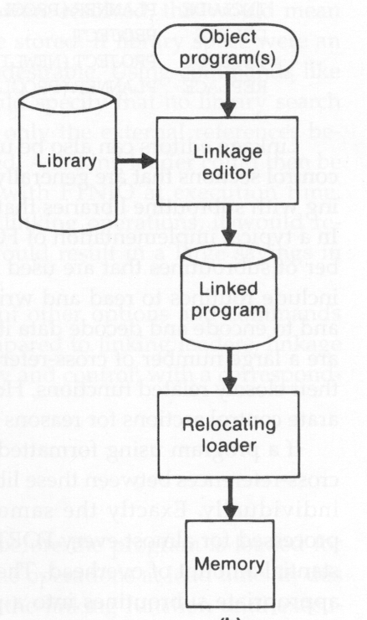
28-03-2019
Linkage Editors
Difference between a linkage editor and a linking loader:
Linking loader
Suitable when a program is reassembled for nearly every execution
In a program development and testing environment
When a program is used so infrequently that it is not worthwhile to store the assembled and linked version.
Linkage editor
Suitable when a program is to be executed many times without being reassembled because resolution of external references and library searching are only performed once.
Linking Loader vs. Linkage Editor

Slide 23
28-03-2019
Additional Functions of Linkage Editors
Replacement of subroutines in the linked program
For example:
INCLUDE PLANNER(PROGLIB) DELETE PROJECT
INCLUDE PROJECT(NEWLIB) REPLACE PLANNER(PROGLIB)
Construction of a package for subroutines generally used together
There are a large number of cross-references between these subroutines due to their closely related functions.
For example:
INCLUDE INCLUDE
: SAVE
READR(FTNLIB) WRITER(FTNLIB)
FTNIO(SUBLIB)
Specification of external references not to be resolved by automatic library search
Can avoid multiple storage of common libraries in programs.
Need a linking loader to combine the common libraries at execution time.
Address Binding
Address Binding:
Symbolic Address (label) € Machine Address
Address Binding:
Assembling Time: 8051
Load Time: 8086
Run Time: Dynamic Linking Library
Address Binding
Complexity, Flexibility

Slide 24
28-03-2019
Linking Time
Linkage editors: before load time
Linking loaders: at load time
Dynamic linking: after load time
A scheme that postpones the linking function until execution time.
A subroutine is loaded and linked to the test of the program when it is first called.
Other names: dynamic loading, load on call
Dynamic Linking Application
Allows several executing programs to share one copy of a subroutine or library.
Allows the implementation of the shared object and its methods to be determined at execution time in an object-oriented system
Provides the ability to load the routines only when (and if) they are needed.
This can result in substantial savings of load time and memory space.
For example, error handling routines.

Slide 25
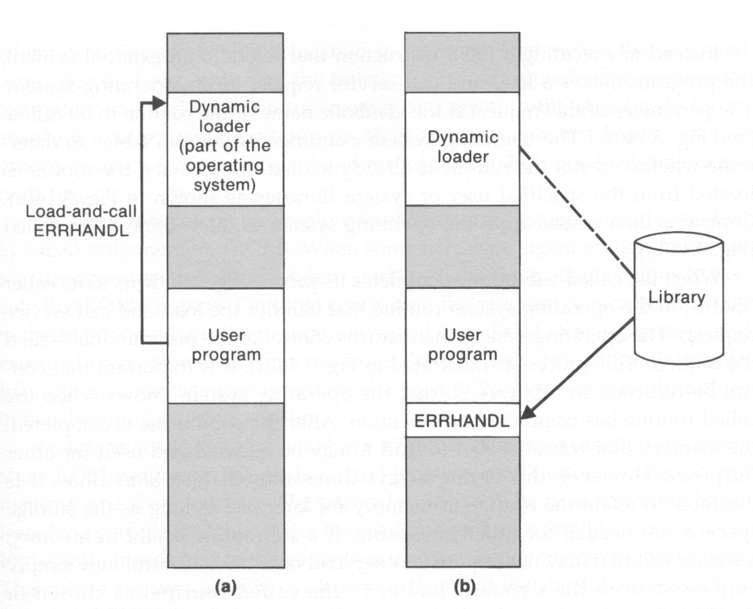
28-03-2019
Implementation of Dynamic Linking
Subroutines to be dynamically loaded must be called via an operating system service request, e.g., load-and-call, instead of executing a JSUB instruction.
The service request will be handled by a part of the OS, called the dynamic loader, which is kept in memory during execution of the program.
The parameter of this request is the symbolic name of the routine to be called..
Example of Dynamic Linking
Issue a load-and- call request
Load the routine from the specified library

Slide 26
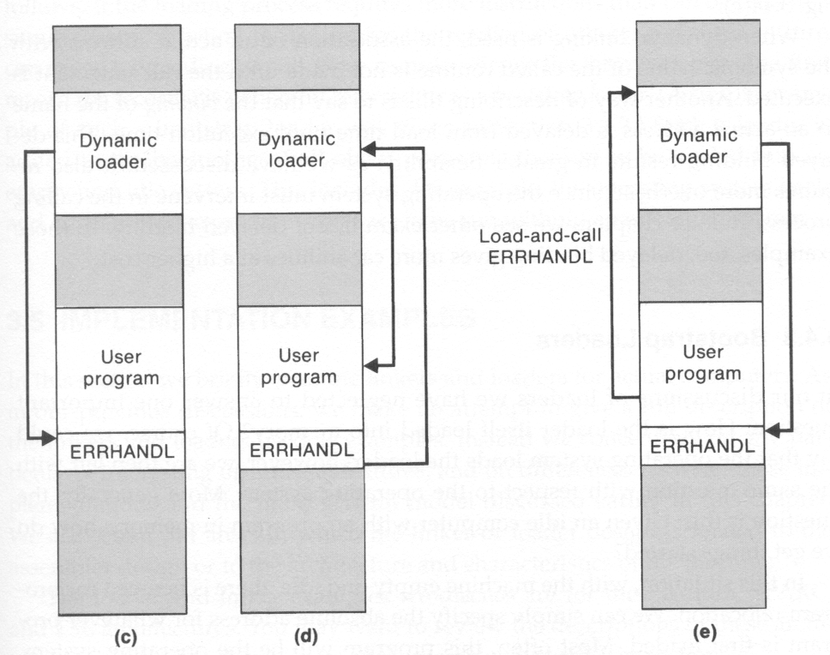
28-03-2019
Jump back to the dynamic loader
Jump to the loaded routine
Jump back to the user program
Second call to this subroutine may not require load operation.
Dynamic Linking
Advantages:
Several executing programs can share one copy of a subroutine or library (Xwindows, C support routines).
The implementation of the method can be determined or even changed at the time the program is run.
The subroutine name might simply be treated as an input item (!)
Additional advantages:
Applications with rarely used subroutines (f.e. errors handling)
Application with a lot of possible services (f.e. mathematic packages)

Slide 27
28-03-2019
Implementation Example -- MS-DOS
MS-DOS assembler (MASM) produce object modules (.OBJ)
MS-DOS LINK is a linkage editor that combines one or more modules to produce a complete executable program (.EXE)
MS-DOS object module
THEADER similar to Header record in SIC/XE
MODEND similar to End record in SIC/XE
MS-DOS object module
TYPDEF
PUBDEF
EXTDEF
LNAMES
SEGDEF
GRPDEF
LEDATA
LIDATA
FIXUPP
data type
similar to Define record in SIC/XE similar to Reference record in SIC/XE
contain a list of segments and class names segment define
specify how segments are grouped similar to Text Record in SIC/XE specify repeated instructions
similar to Modification record in SIC/XE

Slide 28
28-03-2019
SunOS Linkers(3/1)
SunOS actually provides two different linkers, called the link-editor and the run-time linker
The link-editor takes one or more object modules produced by assemblers and compilers, and combines them to produce a single output module
Different types of output modules: relocatable object module, static executable, dynamic executable, shared object
SunOS Linkers(3/2)
The object module includes a list of the relocation and linking operations that need to be performed Symbolic references from the input files that do not have matching definitions are processed by referring to archives and shared objects
An archive is a collection of relocatable object modules Selected modules from an archive are automatically included to resolve symbolic references A shared object is an indivisible unit that was generated by a previous link-edit operation

Slide 29
28-03-2019
SunOS Linkers(3/3)
The SunOS run-time linker is used to bind dynamic executable and shared objects at execution time
When a procedure is called for the first time, control is passed via the linkage table to the run-time linker
The linker looks up the actual address of the called procedure and inserts it into the linkage table, thus subsequent calls will go directly to the called procedure
This process is sometimes referred to as lazy binding
During execution, a program can dynamically bind to new shared objects depending on the exact services required
Cray MPP Linker
Cray MPP (massively parallel processing) Linker is developed for Cray T3E systems.
A T3E system contains large number of parallel processing elements (PEs) – Each PE has local memory and has access to remote memory (memory of other PEs).

Slide 30
28-03-2019
Cray MPP Linker
The processing is divided among PEs - contains shared data and private data.
The loaded program gets copy of the executable code, its private data and its portion of the shared data.
The MPP linker organizes blocks containing executable code, private data and shared data
Cray MPP Linker
The linker then writes an executable file that contains the relocated and linked blocks. The executable file also specifies the number of PEs required and other control information

Slide 31
28-03-2019
Cray MPP Linker
The linker can create an executable file that is targeted for a fixed number of PEs, or one that allows the partition size to be chosen at run time. Latter type is called plastic executable

